Slide 1

Release Management
December, 2013
Notes:
Hi all, thank you for coming.
The idea of this meeting is to talk about bug management process, but before start I’d like to know if you have ever heard something about this new process and what do you know about it?
…people speaking...
Thank U, yes, the bug management process is related what you have tell me. I will try to underline the principal concept behind it.

Slide 2

Content
Why Release Management
Why Release Management revamping
Process scope
Release Process
Release Type
Process Workflow
Windows Timeframe
Working Agreement
Feature Freeze
Emergency Criteria
Metrics
Notes:
This is the general agenda.
We will talking about… (reading the agenda)

Slide 3
Why Release Management
Release Management Process Goals
Release Management is the process responsible for planning, scheduling, and controlling the build and deploying Releases.
Release Management Team provide support for delivers new and enhanced product features required by the business, while protecting the integrity of existing services.
Bug Management Process Goal

Slide 4
Why Release Management
Release Management Process Issues
RM team is working on demand, without an integral planning where its capacity is not under control. There are not shared definition or agreements about was urgencies mean, about how the prioritization is doing and about the escalation model. Those problems effect the RM team and Dev team in the daily work and a huge coordination and effort is required.
Another problem is about visibility and predictability of RM activities, that issue affect development activities such as planning and estimation. The Development team don't know what is the RM effort required to complete a requirement, so that it is difficult to made an accurate estimation
Those problems affect the Lead Time processes metrics.
Bug Management Process Goal

Slide 5
Why Release Management revamping
Facilitate release tracking.
Visibility of release to business and IT support staff.
Unify an emergencies mechanism
Allow us to:
Unify release type description and registration.
Align release activities and priorities with those of the business.
Improve release quality thru metrics
Give order to internal organization to ensure good response
Bug Management Process Goal

Slide 6
Process Scope
Release Team Scope
Provide support for delivers new and enhanced product features required by business, while protecting the integrity of existing services
The primary goal of the Release Management Process is to increase the number of successful Releases, including reducing the number of Releases with unexpected outcomes and decrease the number of incidents caused by Releases
Process Scope
This process applies to release to Production Environment requested by OLX Teams.
Any Release provided by Suppliers are excluded of this initial version. Development and testing env. requests are not part of this process either, however some of agreements of this process could be applied.

Slide 7
Release Types
Release Types
HotFix (Emergency Release )
It is a release based on critical bug or incident. It is a non-planned and highest priority release. When a Emergency Release is requested, Major Release Plan and RLS Queue would be affected.
Major Release
It is an average or high complex release request that is part of the Major Release Plan. Major Releases are the ones that include steps for other teams than RM team, like DBA team or DC Team. Eg: SQL scripts, Rewriterules, DNS changes, Restart services, flush memcache instances (outside the usual restarts and flushes). It represents the highest priority planned Release. It must be scheduled to a specific date, due to the effort required and risk associated to the change. Each change on the Major Release Plan would affect priorities, effort and capacity.
Minor Release
It is a normal release requested within the windows timeframe defined. Mainly it is represented by on-demand RLS request that is created based on team needs. It is subordinated to the Emergencies Release and Major Release Plan

Slide 8
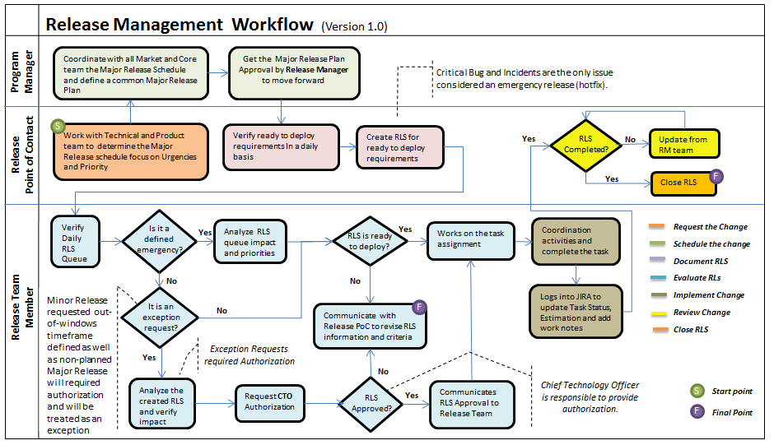
Release Workflow

Slide 9
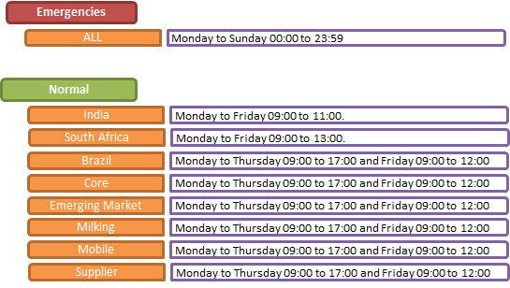
Windows Timeframe
RM windows timeframe for Normal Request is from Monday to Thursday from 9:00 to 17:00 and Friday from 9:00 to 12:00 and it is defined just for Production Environment. India and South Africa Team have a different timeframe but this is just to define priority on its request, if a RLS is requested within the timeframe defined will be treated as a High Priority, out-of this windows timeframe will be part of the normal RLS Queue mechanism.

Slide 10
Working Agreements – aka Policies
Release Point of Contact
A single “Release PoC – Point of Contact” must be identified in every Team.
Major Release Plan
Program Coordinator and Release Manager must define and communicate the weekly release Plan based only on Major Release for the specific week.
Queue Mechanism
All RLS requests that are not part of the Major Release Plan is managed using a Queue.
The Release PoC will be responsible for successful coordination and execution of the Release Process for that team, as well as ensuring all required information related to the RLS is provided.
It is expected that all Major Release should be completed by the Planned End Date/Time defined.
The Queue will be manage using the FIFO concept where every team is able to create RLS request on demand.
Emergency Criteria
RLS Visibility
RM team provide a JIRA board to all teams to see the progress of each RLS request as well as the RLS Queue.
Critical Bug and Incidents are the only issues considered as a standard emergency release (Hotfix), they would affect RLS Queue. Exceptions will required CTO authorization.
RM Team will received a notification when a Critical bug or Incident is created

Slide 11
Working Agreements – aka Policies
Manage Changes
Every Day the RM Team verify the RLS Queue communicating every changes to the team involved.
Changes in Major Release Plan are controlled and managed by Program Coordinator.
Urgencies and Unplanned activities that impact the RLS Queue are managed in a daily basis.
Windows Timeframe
Release PoC and RM team will use the Windows Timeframe defined for coordination and execution of RLS request.
Normal RLS requested out-of-windows timeframe defined will required authorization by CTO and will be treated as an exception.
Release Support
Every execution of a RLS requested should be attended by the RM (or any replacement if he is absent for any reason), a SysOp from Infrastructure Team, a DEV resource responsible for the deployed features and a designated team member for testing as soon as the RLS is LIVE
Feature Freeze
Feature freeze mean that the team are not able to do merge on Master Branch. Just Bug Fixing is allow.
Feature Freeze take place on the day before to CORE Release. Every Release on Monday at 12:00pm to Wednesday at 10:00am
Formal Channels
The formal channels that must be used are JIRA, #release IRC channel as well as release@olx.com emails address.

Slide 12
Feature Freeze
Feature Freeze
Tuesday day: Every team must ensure that the integration of our platform doesn't have any issue related, that means that all teams need to start immediate a regression test in testing environment. If something is wrong Release PoC must contact RM team to review it and resolved the issue immediately.
Wednesdays 10:00AM: The full release to PROD is made and testing env. is unblocked , the RM, a DBA and a SysOp are always present during this process, but there also should always be DEV team members ready to test as soon as this is ONLINE
Monday's noon: Every Release Cycle (Two Weeks) you will receive an email from the RM letting you know Feature Freeze, which means that no new features are to be committed and testing env. is about to be blocked. Only emergencies issues are accepted (critical bugs and app incidents).
Bug Management Process Goal

Slide 13
Emergency Criteria
Emergency and Exceptions Criteria
Critical Bug and App Incidents are the only issues considered as a standard emergency release.
All exception requested will be tracked and measured to analyze root cause and define action plan to reduce those situations (Action Plan will be part of the our continuous improvement process mechanism)
RM Team will received a notification when a Critical bug or Incident is created.
Minor Release requested out-of-windows timeframe defined as well as non-planned Major Release will required CTO authorization and will be treated as an exception.
Bug Management Process Goal

Slide 14
Metrics
Process analysis
Release Quality
Amount of RLS
Cumulative RLS
RLS With Rollback
Successful vs. Unsuccessful
Critical Bugs
Emergencies RLS
RLS answer Time
RLS resolution lead time
Exception RLS
Authorized Request (Approved by CTO)
App Incident
by team & Release Type
by team & Release Type
Notes:
Initially in a two weeks basis

Slide 15
Process Implementation Plan
Communicate new Initiative
CTO – Nov 10-13
Central PLD Team (Dec 10/13 - Scheduled)
Mobile Team (Dec 10/13 - Scheduled)
Emerging Market Team (Dec 10/13 - Scheduled)
Core Team (Dec 11/13 - Scheduled)
Milk Team ( Dec 11/13 - Scheduled)
Brazil Team (Dec 11/13 - Scheduled)
South Africa Team ( Dec 17/13 - Scheduled)
India Team (Dec 17/13 - Scheduled)
Get feedback from the specific teams involved
Set Up
Ready
Dec 20-13
(Define GO or Not GO according to feedback and request for approval)
Launch
Process
Jan 6-14
Monitor
the Process
January 14 to June 14

